Slide 1

silver oak COLLEGE of COMPUTER application
PROJECT NAME: VERTIGO PALACE

Slide 2
Division m1a3
No website Refered

Slide 3
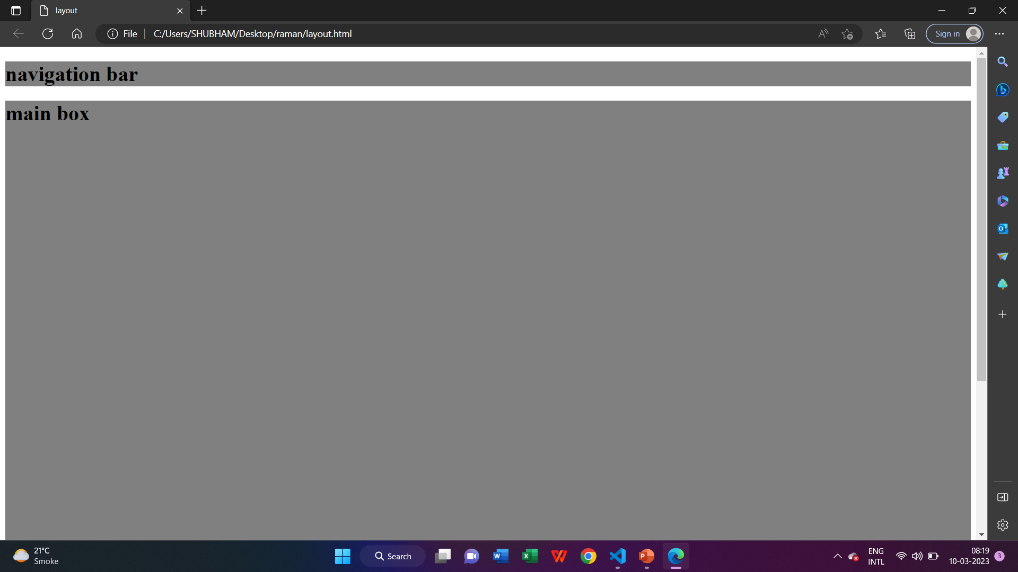
Lay out

Slide 4
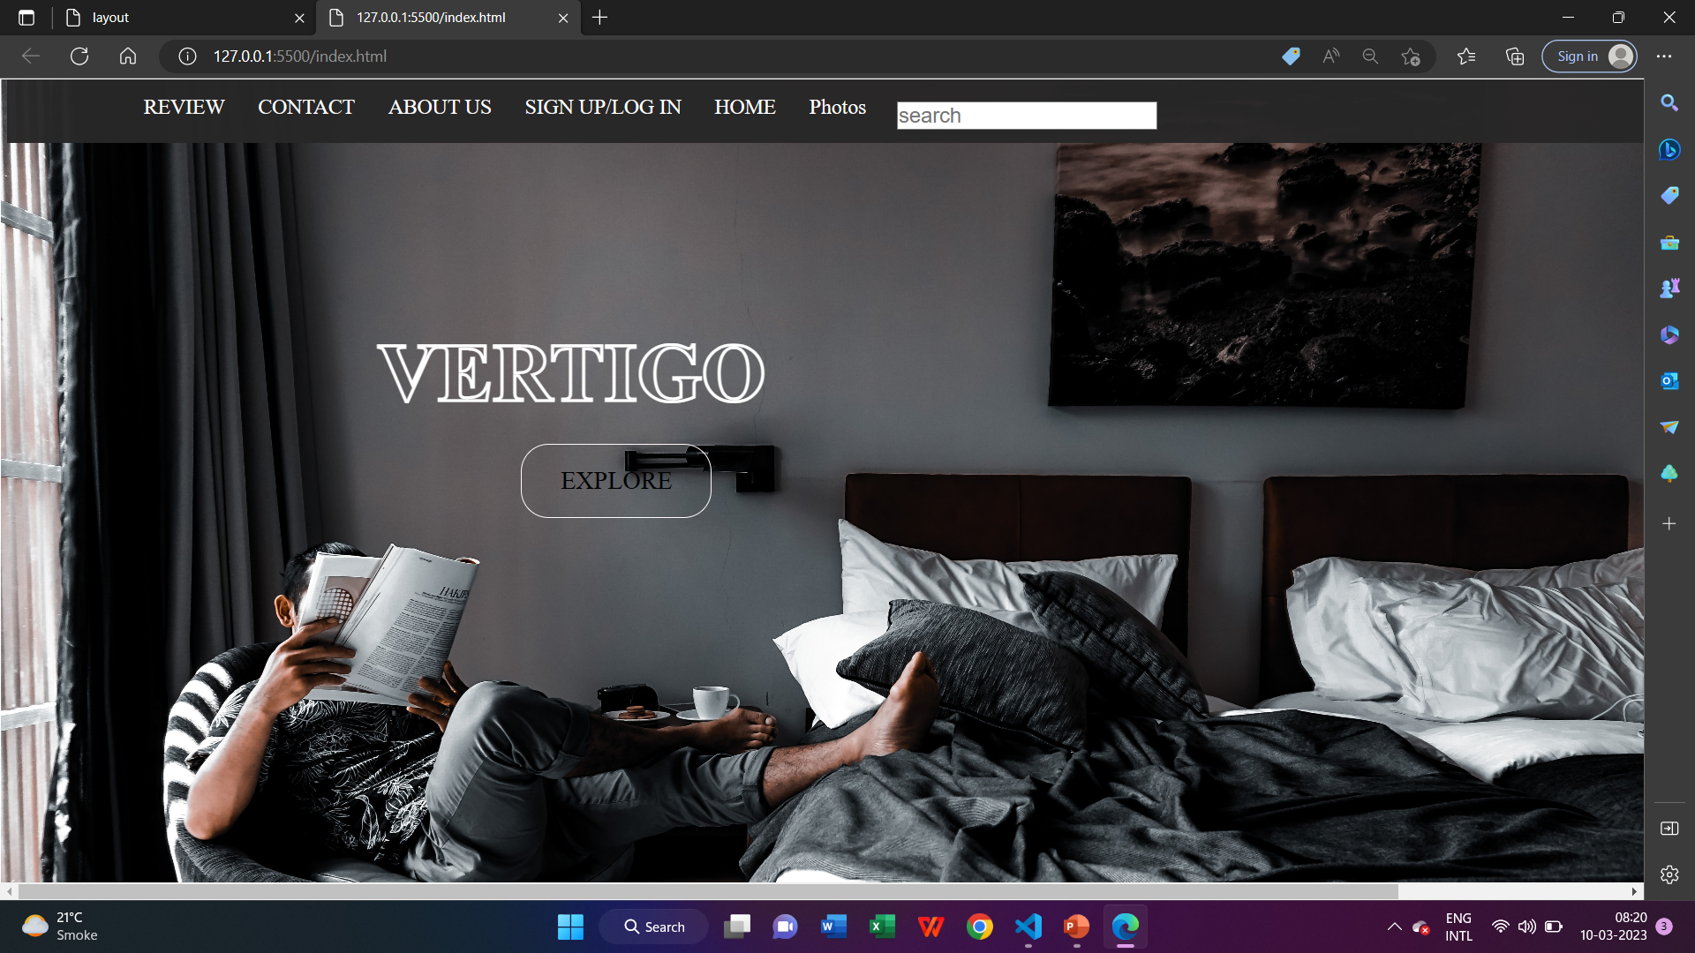
Home page

Slide 5
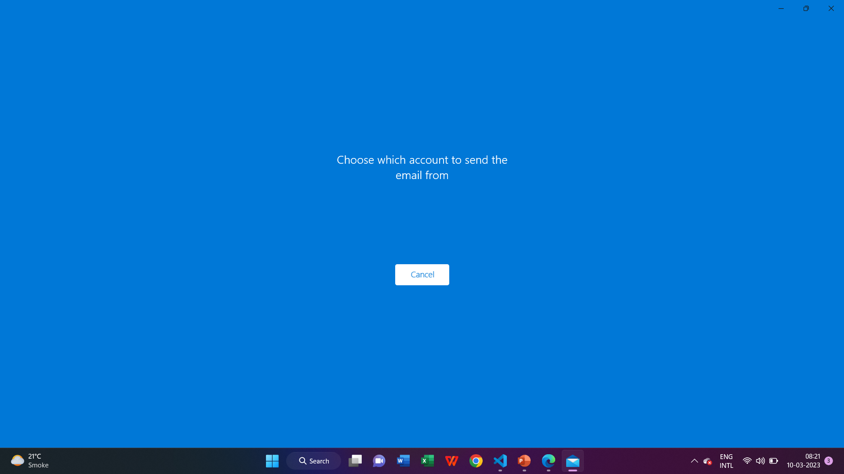
contact

Slide 6
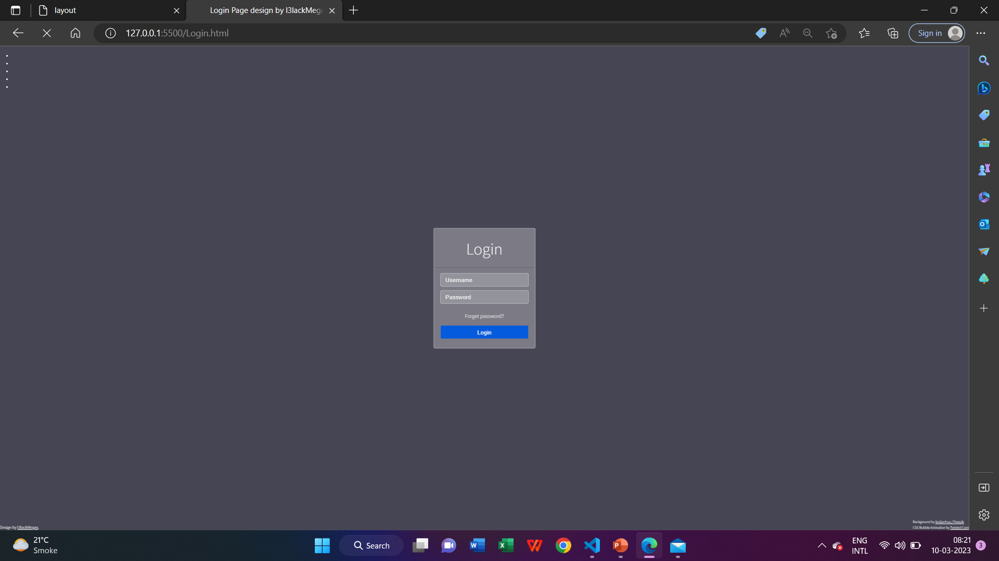
Log in

Slide 7

THANK
Name: Raman verma
Mail:ramanverma9099@gmail.
com
You

